Slide 1
The Bike Shop
PRODUCT PEFORMANCE ANALYSIS

Slide 2

PURPOSE OF ANALYSIS
THIS IS A MARKET RESEACRH ANALYSIS TO UNDERSTAND PRODUCT PEFORMANCE AT DIFFERENT “THE BIKE SHOP” OUTLETS THOUGHOUT THE UNITED STATES WHERE THE STORE BRAND HAS PRESENCE.
THE ANALYSIS WILL FOCUS ON THE TOTAL NUMBER OF PRODUCTS SOLD BETWEEN AND WOMEN, HIGHEST AND LOWEST SELLING PRODUCTS, THE HIGHEST AND LOWEST PEFORMING STATES, AND THE AGE GROUP AND GENDER IN WHICH MOST CUSTOMERS ARE COMPRISED TO BETTER UNDERSTAND THE CONSUMER CLIMATE AND OVERALL FEELINGS TOWARDS CYCLING.

Slide 3
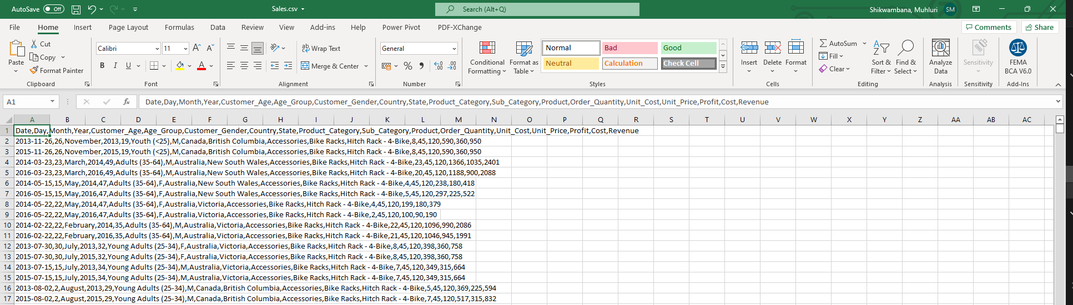
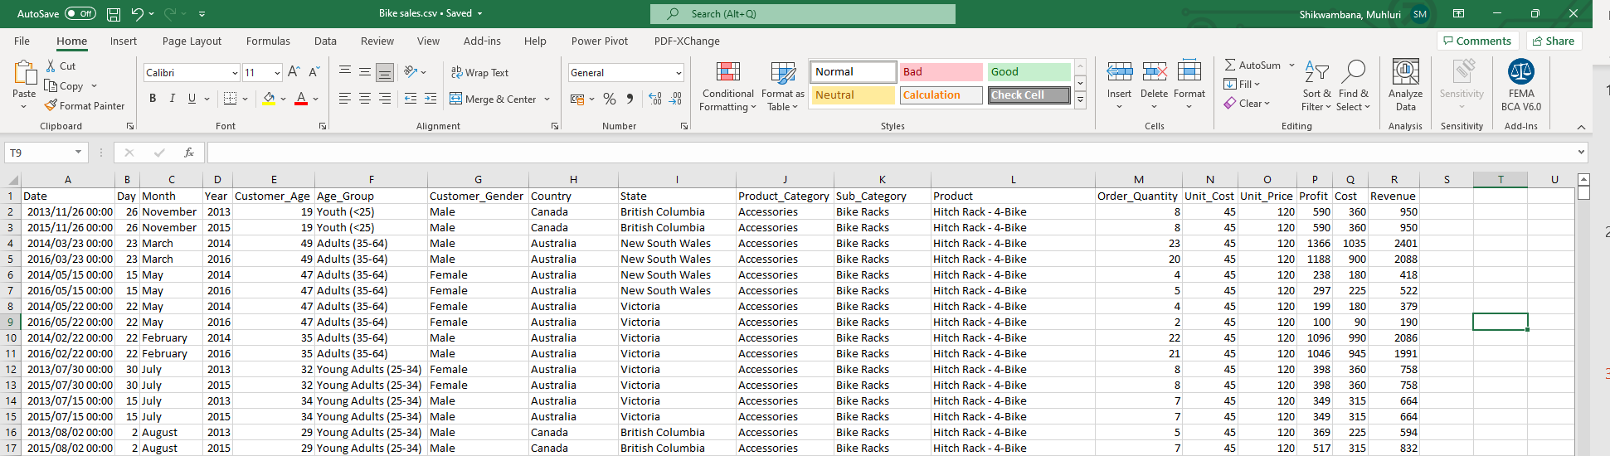
DATASETS & DATA CLEANING
Collected some dummy data on kaggle.com. Other free sources of data include:
STATS SA
UNdata
Google Public Data Explorer
Data collected was in a .csv file format. However data can be collected in different formats which include .xml, .xls, .txt, and various other formats depending on the source and programmes used.
As abovementioned, the data used in this analysis was collected in a .csv format from kaggle.com. The data was unstructured and only differentiated by the use of commas. I then went onto cleaning the data on excel using the following steps:
Highlighting all the data in column A
Clicking on the Data tab in the ribbon, then clicking ‘Text to Columns’
In the ‘Text to Columns’ wizard, clicked on “Delimited” radio button before clicking next.
I then set my delimiter to ‘Comma’ and clicked next again.
I did not change the format of my data as I was quite satisfied with the format, however if I wanted to change the format of a specific column in the data set, you could click on the specific column and change the data set before clicking ‘Finish’.
Once the data is cleaned, and structured correctly, the data can be transformed and grouped if required for analysis

Slide 4

DATA VISUALIZATION
Data visualization is the use of graphs and charts to visualize and tell a story about the data gathered. There are various applications and software programmes that can be used to visualize data, and Microsoft PowerPoint is one of the tools that can be used to visualize data collected in excel.
The ‘Customer Segments’ chart was created on PowerPoint linking and transforming the cleaned data to represent the findings of “Total number of customers in a specific age group.”
In the excel file, the total number of customers in an age group can be calculated using the COUNTIF function to count only the number of items in a specific range.

Slide 5
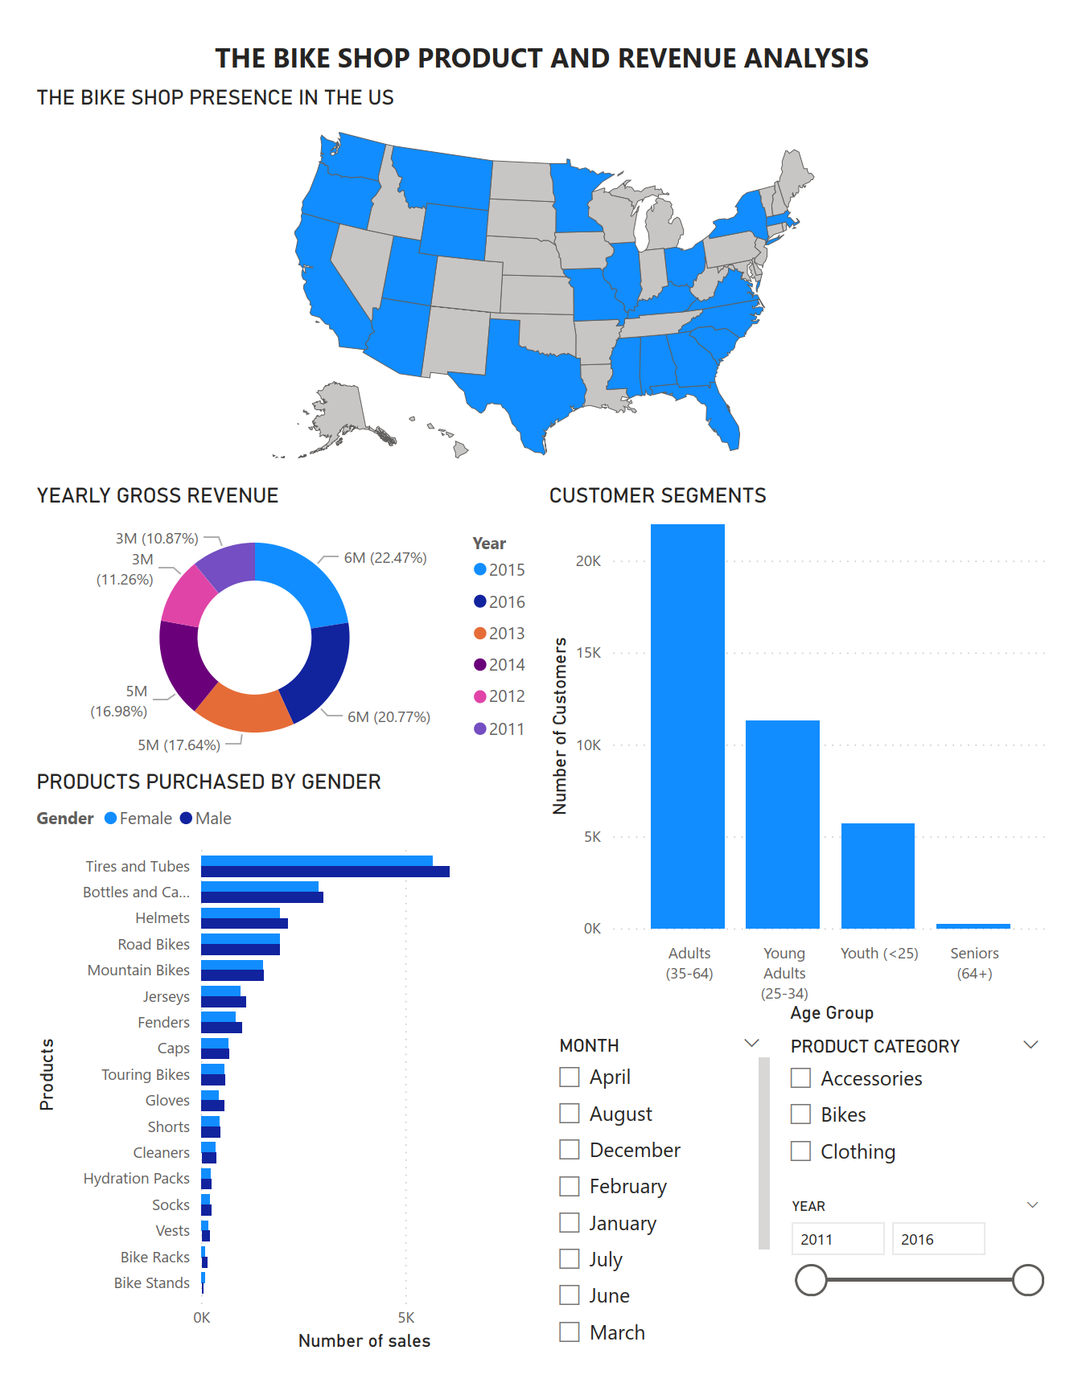
DATA VISUALIZATION cont.
PowerBI is another tool I used to visualize data from the The Bike Shop dataset that I cleaned. I used the following visuals to create my dashboard:
Shaped map – to represent the states in which The Bike Shop has a store.
Donut chart – to show the distribution of sales in % for the years the data has been collected.
Clustered column chart – to visualize the customer segments by age group.
Clustered bar chart – visualising the total number of products bought between Male and Female.
In the dashboard, I have also added two splicers to allow anyone interacting with the dashboard to filter the view of the entire dashboard, allowing them to view specific information.
It is worth noting that the dataset includes purchases from The Bike Shop in different countries, and I have managed to isolate the visualization by adding an overall filter to all the pages by clicking and dragging the ‘Country’ data tag into the ‘Filter on all pages’ data field. This ensures that only data from the United States is visualized.

Slide 6
INSIGHTS & ANALYSIS
Based on the visualizations, we can deduce the following insights about The Bike Shops’ clientele;
Their largest customer segment is Male, with men spending more overall on the entire product catalogue.
Adults (35 – 64) make up the largest consumer segment, and seniors (+65) make up the smallest consumer segment.
The highest selling product in volume for both genders are tyres and tubes.
The Bike Shop has little to no presence in Midwest United States.
The following analysis can be made from the graphs in the dashboard;
Although tyres and tubes are the highest selling items, mountain, road and touring bikes produce the highest revenue year-on-year.
Young adults and adults make up the highest consumer segment because they are the most health conscious age groups and therefore are the most active.
Adults replace the tyres and tubes on their bikes more frequently.
Only seniors in the west coast (Washington, Oregon, and California) own bikes, which may mean seniors in other states either do not own bikes, have bought their bikes from other outlets, or there is no data recorded of their bike purchases, if any.

